Slide 1


Assignment 8.1 JSP Custom Tags
Austin Salameh

Slide 2
Contents
Index.html
01
JSP form and custom tag
02
Db return with custom tag
03

Slide 3

Index.html

Slide 4
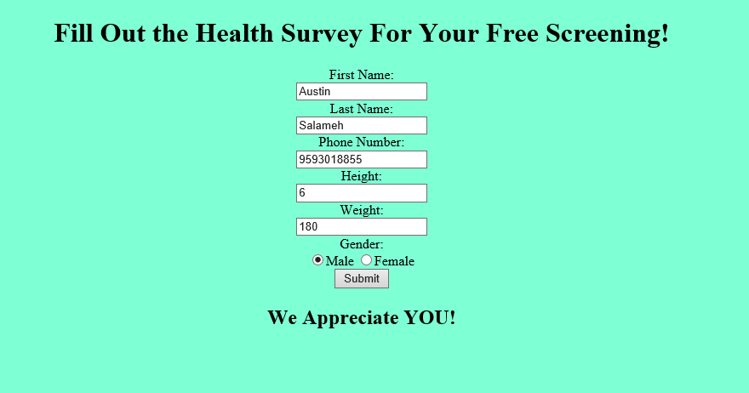
JSP Form with the custom tag at the bottom

Slide 5
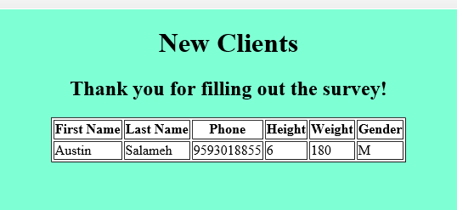
DB Return along with another custom tag thanking the user

Slide 6
Thanks!

